Slide 1
基于多波段注意力机制的语义分割
——张玮雯

Slide 2
基于多波段注意力机制的语义分割
VS
ResNet101
cov
cov
＋
MPAM
IR
ResNet101
VS
IR
Vs and IR
共有特征A
PAM
独有特征B-A
cov
VS
concat
VS
特征B
PAM
独有特征C-A
IR
IR
特征C
PAM

Slide 3
 | car | bicycle | person | sky | plant | traffic light | road | sidewalk | building | fence | sign | pole | bus
Deeplab-ResNet（可见光） 50.95/86.6 | 75.3 | 29.22 | 32.5 | 74.34 | 77.62 | 32.45 | 91.5 | 35.58 | 66.14 | 32.17 | 27.14 | 28.86 | 59.5
Deeplab-ResNet（红外） 39.90/80.54 | 52.29 | 20.15 | 47.48 | 72.64 | 69.28 | 14.81 | 85.26 | 38.21 | 59.12 | 9.67 | 0.67 | 9.24 | 39.89
NIN 52.13/87.18 | 75.5 | 34.89 | 50.07 | 81.81 | 77.23 | 23.71 | 94.73 | 60.12 | 66.54 | 33.56 | 19.28 | 34.07 | 26.13
MCAM 54.9/87.95 | 84.17 | 41.49 | 49.01 | 79.30 | 77.07 | 23.84 | 94.67 | 58.21 | 64.42 | 42.03 | 21.21 | 34.46 | 43.85
MCAM_l3 53.00/86.51 | 79.68 | 44.61 | 52.01 | 79.97 | 76.56 | 33.35 | 93.83 | 51.17 | 63.36 | 30.86 | 27.18 | 30.01 | 26.43
MPAM 54.47/88.33 | 83.91 | 41.15 | 47.22 | 81.75 | 78.14 | 21.69 | 93.89 | 47.66 | 66.65 | 42.10 | 22.35 | 36.45 | 45.10

Slide 5
Miou / Pacc | car | bicycle | person | sky | plant | traffic light | road | sidewalk | building | fence | sign | pole | bus
MPAM 54.47/88.33 | 83.91 | 41.15 | 47.22 | 81.75 | 78.14 | 21.69 | 93.89 | 47.66 | 66.65 | 42.10 | 22.35 | 36.45 | 45.10
MPAM-特征加强 55.39/88.37 | 84.73 | 41.38 | 53.04 | 81.89 | 77.51 | 19.36 | 94.53 | 49.97 | 66.05 | 49.50 | 24.79 | 34.83 | 42.51
MPAM-特征加强-noA 56.8/87.89 | 86.23 | 40.47 | 44.01 | 69.89 | 77.27 | 33.11 | 94.52 | 57.22 | 62.68 | 46.36 | 24.84 | 37.74 | 64.03
MPAM-特征加强-NIN 53.42/87.59
MPAM-特征加强- 两两NIN再级联 52.34/86.90
MPAM-特征加强- 两独有级联再和共有相加

Slide 6
Miou / Pacc | car | bicycle | person | sky | plant | traffic light | road | sidewalk | building | fence | sign | pole | bus
MPAM 54.47/88.33 | 83.91 | 41.15 | 47.22 | 81.75 | 78.14 | 21.69 | 93.89 | 47.66 | 66.65 | 42.10 | 22.35 | 36.45 | 45.10
MPAM-特征加强 55.39/88.37 | 84.73 | 41.38 | 53.04 | 81.89 | 77.51 | 19.36 | 94.53 | 49.97 | 66.05 | 49.50 | 24.79 | 34.83 | 42.51
MPAM-特征加强-noA 56.8/87.89 | 86.23 | 40.47 | 44.01 | 69.89 | 77.27 | 33.11 | 94.52 | 57.22 | 62.68 | 46.36 | 24.84 | 37.74 | 64.03
MPAM-4C分加 56.17/88.92 | 84.58 | 41.20 | 52.75 | 83.59 | 79.55 | 24.35 | 93.66 | 50.33 | 67.63 | 42.93 | 23.28 | 35.60 | 50.72

Slide 7
55.39/88.37 A B-A B-C
56.8/87.89 B-A B-C
53.42/87.59 最后NIN到1024 A B-A B-C
52.34/86.90 两两NIN再级联 A B-A B-C
53.73/86.51 两独有级联再和共有相加 0.5*A+0.5*B-A B-C
53.51/87.47 两独有级联再和共有相加 A+B-A B-C
56.17/88.92 4部分相加 A1+A2+B-A+B-C
55.89/88.72 4部分相加 0.25*A1+0.25*A2+0.25*B-A+0.25*B-C
55.29/88.56 4部分相加 0.5*A1+0.5*A2+0.5*B-A+0.5*B-C

Slide 8
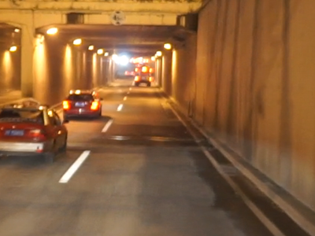
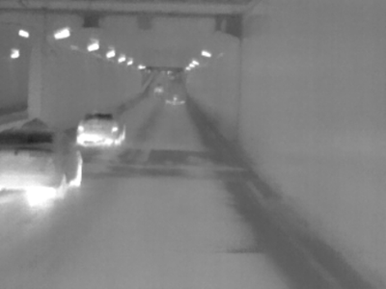
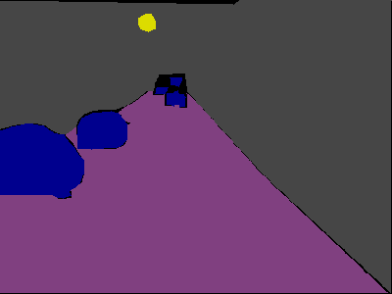
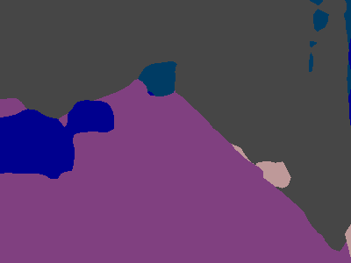
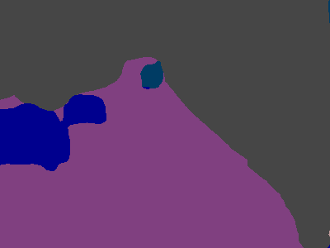

图401【4c级联】【仅独有特征】【4cpartSUM】
Notes:
car聚集在一起的容易分成bus
【4c级联】中road和building部分

Slide 9
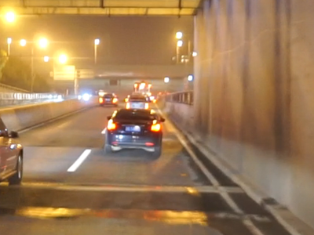
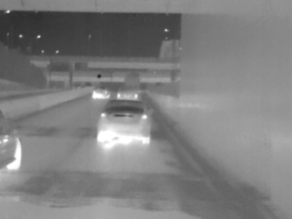
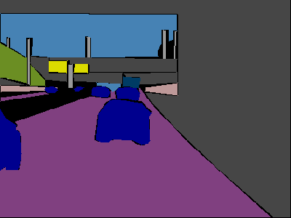
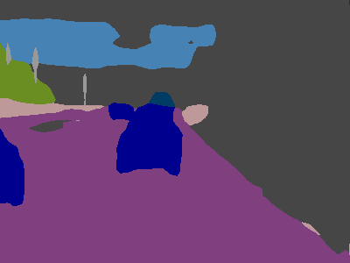
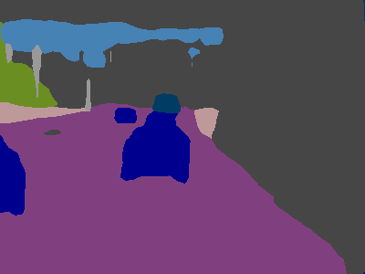
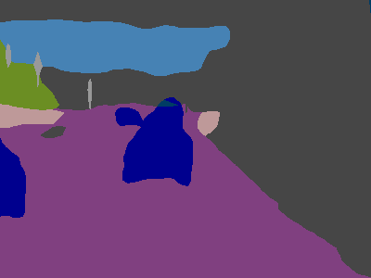
图409【4c级联】【仅独有特征】【4cpartSUM】
Notes:
【仅独有】对是否是bus的敏感度更高，误判率低
【4cpartSUM】对sky准确度高

Slide 10
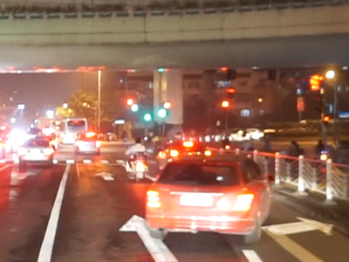
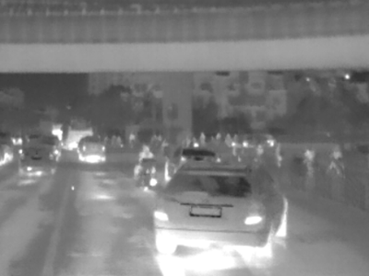
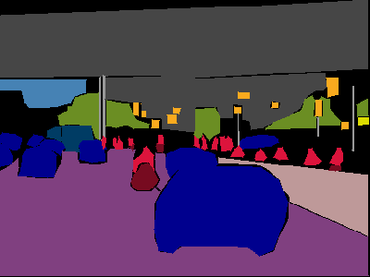
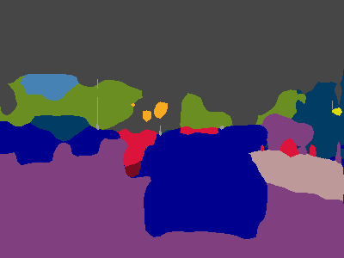
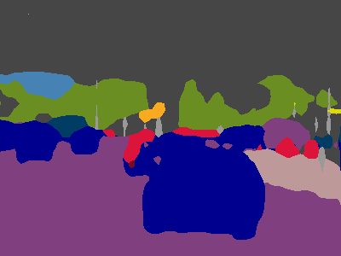
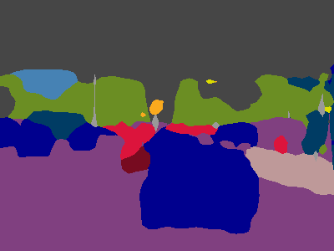
图424【4c级联】【仅独有特征】【4cpartSUM】
Notes:
【仅独有】对bus的判断更准确
【4cpartSUM】对person判断更准
都对person无法独立分割

Slide 11
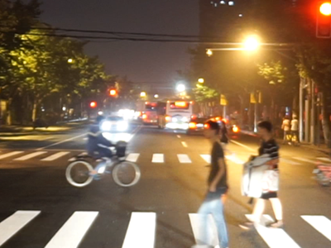
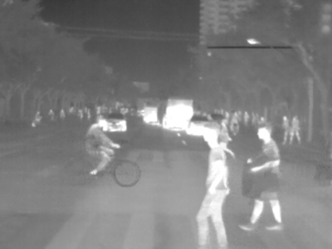
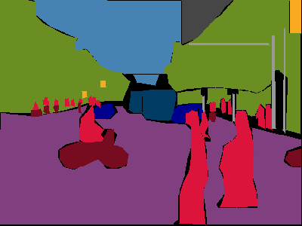
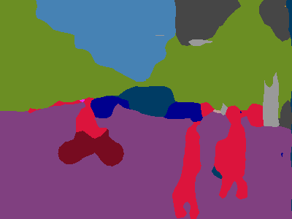

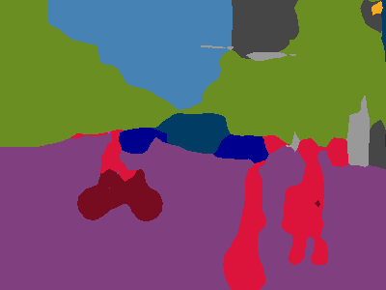
图450【4c级联】【仅独有特征】【4cpartSUM】
Notes:
【4cpartSUM】对person判断更准确
【仅独有】对traffic light判断更准确

Slide 12
图450【4c级联】【仅独有特征】【4cpartSUM】
Notes:
【4cpartSUM】对person判断更准确
【仅独有】对traffic light判断更准确

Slide 13
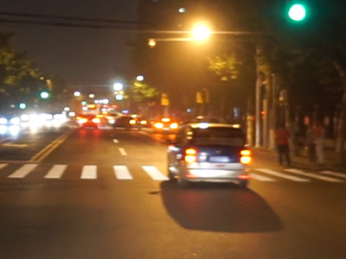
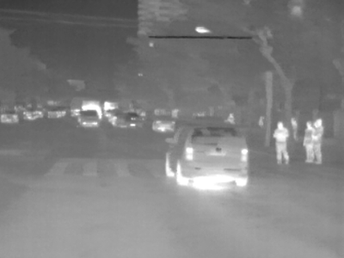
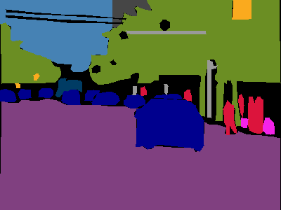



图466【4c级联】【仅独有特征】【4cpartSUM】
Notes:
【仅独有】对sidewalk判断更准确

Slide 14
图450【4c级联】【仅独有特征】【4cpartSUM】
Notes:
【仅独有】对sidewalk判断更准确

Slide 15
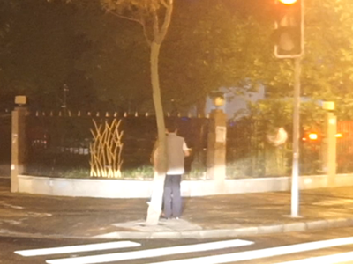
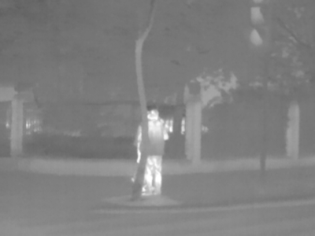
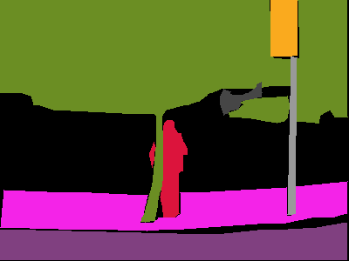
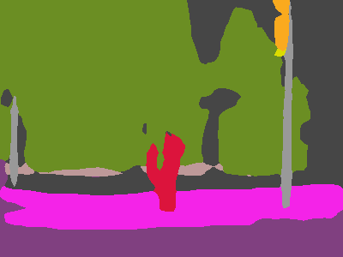
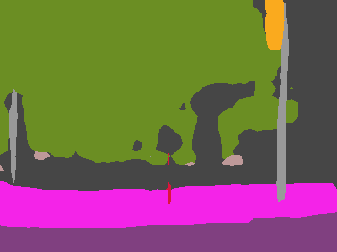
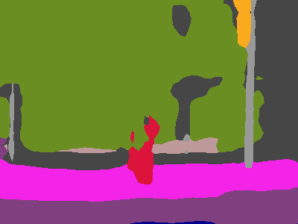
图469【4c级联】【仅独有特征】【4cpartSUM】
Notes:
【仅独有】对person的判断缺失

Slide 16
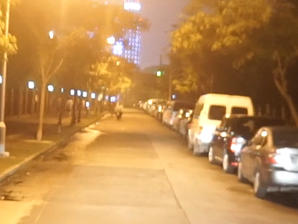
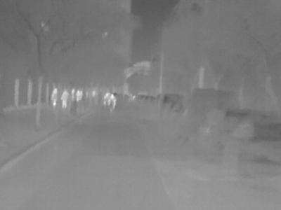
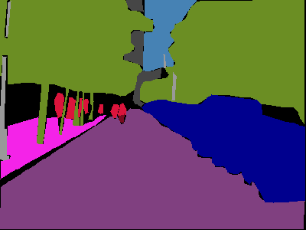
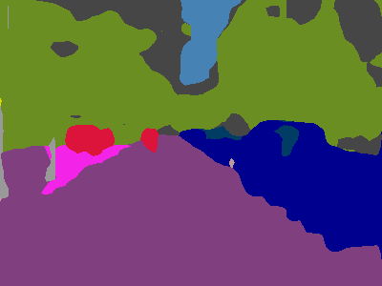
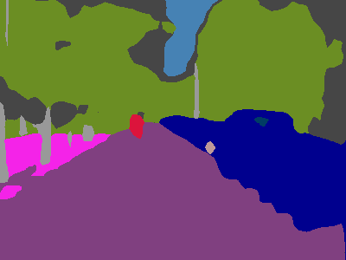
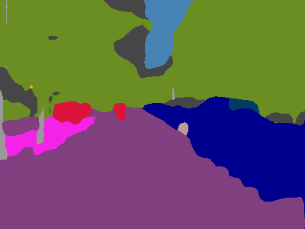
图490【4c级联】【仅独有特征】【4cpartSUM】
Notes:
【仅独有】对person的判断缺失

Slide 17
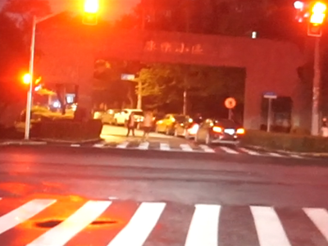
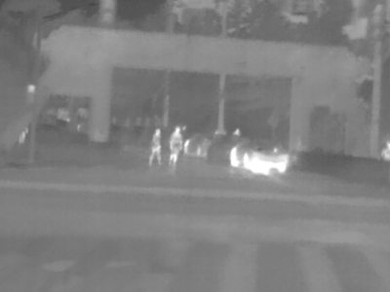
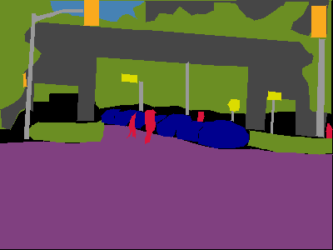
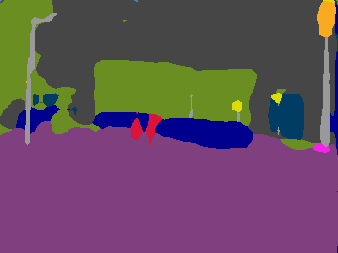
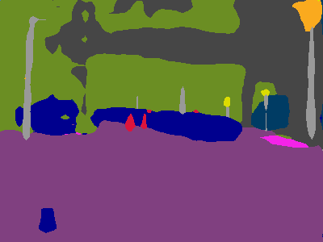

图528【4c级联】【仅独有特征】【4cpartSUM】
Notes:
【4cpartSUM】分割的更好

Slide 18
THANKS

